Slide 1
Fall 2017 Recap
Initial thoughts on topics for Spring 2018

Slide 2
Course Recap
Micro services
Programing language agnostic.
Containers, CI/CD – DevOps in general.
Writing software in the Open.
Architectural choices.
Distributed System Concepts
Raft, Distributed Logging, Messaging, Distributed Co-ordination
Real-world application – Contributions to a production “Platform as a Service” and “Software as a Service” Systems.

Slide 3
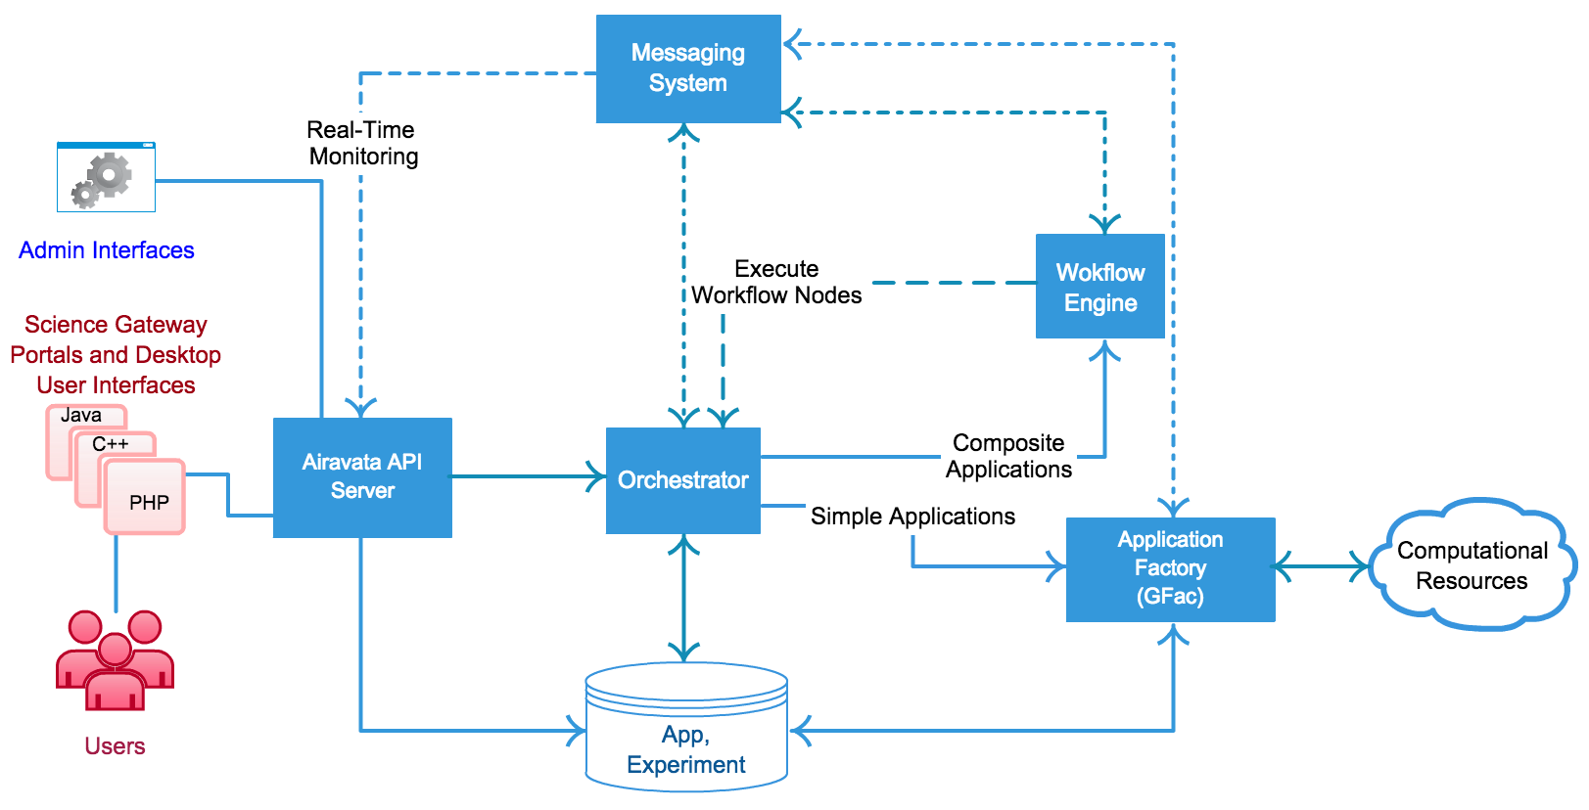

Slide 4
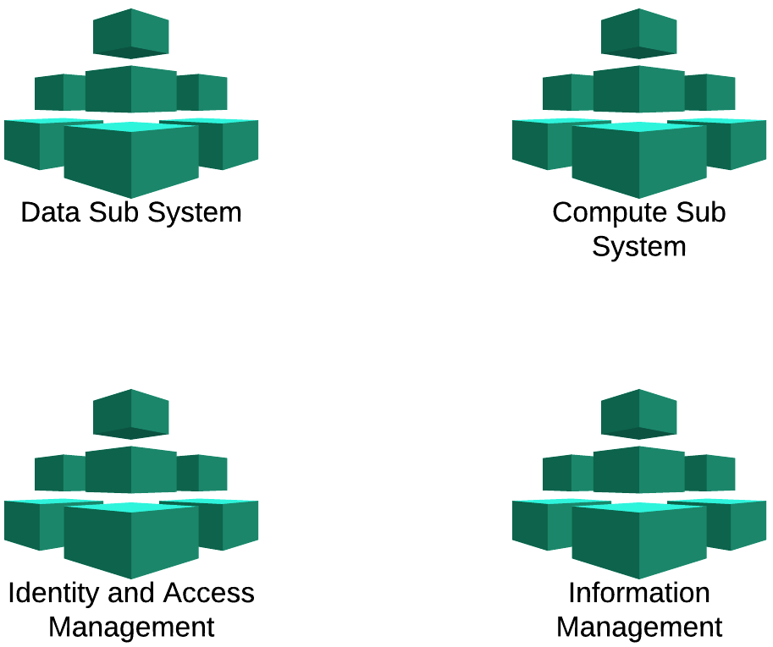
Airavata Development in Spring 2018
Move from current monolithic API driven approach to more loosely coupled “sub systems”.
Each sub system constitutes of many micro-services.
Based on the context, these sub systems will be coupled.
Moving from a centralized API to context driven SDK’s.

Slide 5
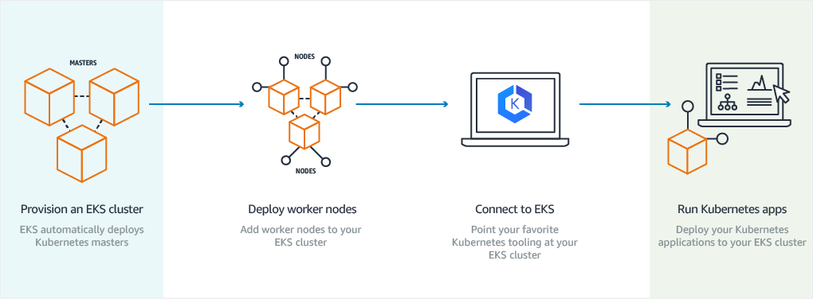
DevOps
Everything as a Container
Kubernetes based
Will closely follow the new Amazon EKS Service

Slide 6
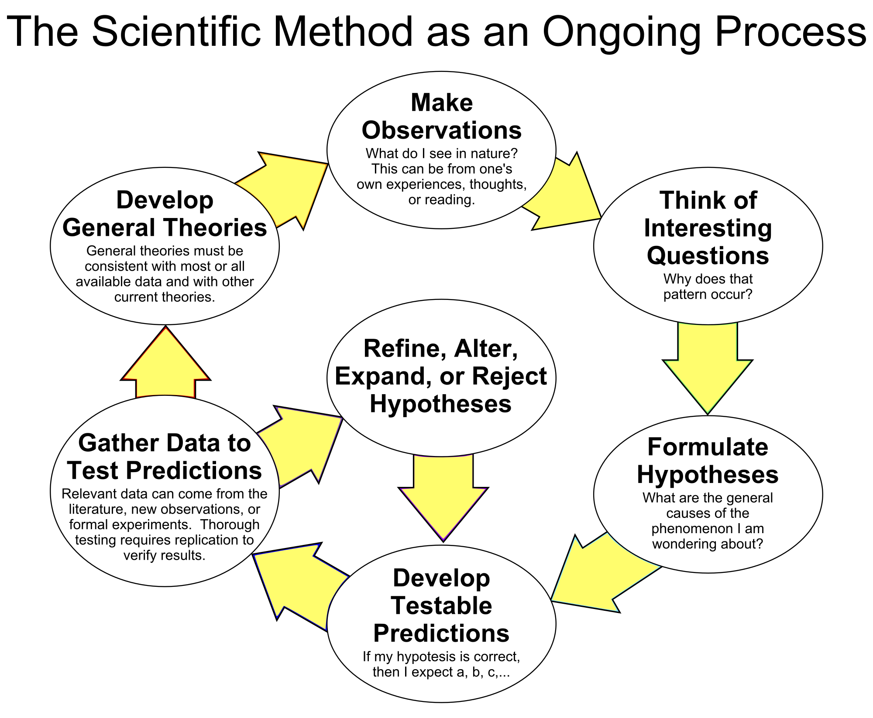

Slide 7
Task Execution Framework
Gourav Shenoy and Team
https://figshare.com/articles/Evaluating_Big_Data_Frameworks_To_Simplify_Distributed_Task_Execution_In_Apache_Airavata/5483743
Dimuthu’s Proposal – Kafka based system
Final conclusion – Use Apache Helix
Browse through Airavata Dev List discussions for the rational and also the provenance on how such decisions are made.
In the Spring 2018 course you can make similar recommendations and follow through.

Slide 8
Data-Centric Computing
Wrap up Registry Refactoring
Craft a first class Data Service Provider API (internally uses current components).
Integration with Globus, DropBox like tools for seamless data movement.
Integrating with large scale observational and experimental data catalogs.
Build upon simulation output parsing system and search capabilities
https://scnakandala.github.io/assets/papers/2016/gce-2016.pdf

Slide 9
Raft - Byzantine Failures
What if a Raft cluster member doesn’t behave like it is supposed to?
Byzantine failure sources
Bugs in software
Hardware and networking issues
Malicious cluster members
These types of problems are known academically as “the Byzantine Generals Problem”
Flavius Belisarius

Slide 10
Log-Centric Airavata
Help with prototyping log-centric Airavata
See Dimuthu’s postings
Develop and evaluate prototypes that use Raft-like strategies for updating stateful services like the Airavata Registry
Develop and evaluate prototype approaches like Practical Byzantine Fault Tolerance and Blockchain that can be used in log-centric Airavata
Decide if this is worth the effort

Slide 11
Security Topics
What is the best way to distribute OAuth2 public clients that will directly access the API
Desktop applications
Jupyter
Other scripts, developer keys, etc
Issues with public clients
The clients themselves need client IDs and client secrets
Users of the clients must further authenticate themselves
This should work with non-browser clients
What are the best approaches for internal (microservice-to-microserivce) security in Airavata?
Byzantine Fault Tolerance
DevSecOps
Black hat hacking

